Slide 1
Awareness and Discovery: Year One of a STEM Elementary School

Slide 2
Introductions
TOSA – Tammy Koeppen
TOSA – Melissa Grabarkewitz
TOSA – Greg Nicholas
Principal – Pam Roden

Slide 3
A Team with a Vision 2013-14
How do we build awareness and understanding of STEM at E. Hale Curran?
MVUSD Board of Education Meeting
STEM Leadership Team
Parent Information Meeting
Cue Conference
STEM School Visits
Invention Convention Showcase
STEM Implementation Plan

Slide 4
Infrastructure: Is a structure and process in place to support the program’s mission, vision and goals?
Leadership team and/or teachers work on school vision and mission
Classrooms are designed or oriented organized for collaborative work
Classroom locations facilitate teacher collaboration
Teachers and students have increased access to technology
Teachers use media tools to communicate STEM activities
Student work is showcased in the community
Community members are invited to participate in some classroom activities
Develop STEM partnerships – Business and Community
Parent/Community STEM Meetings

Slide 5
Instruction: Does the instructional environment provide time and professional development for educators to develop and improve their craft of pedagogy and content?
Mindset: The New Psychology of Success – Year-long Theme
Professional Learning Communities (PLC) Revisited
Grade level Collaboration Meeting used for data analysis
STEM School Visits and Observations
STEM Teacher Focused Walk-Throughs
CUE Conference
California STEM Conference
California Science Teachers’ Conference (Long Beach)
Riverside County STEM Network Meetings

Slide 6
Curriculum: Is our STEM curriculum aligned to the California Common Core State Standards and Next Generation Science Standards?
Next Generation Science Standards Professional Development Sessions
Science A – Z Curriculum
STEM Lab (Exploratorium)
Grade level teams collaboratively plan and teach one integrated (cross curricular) STEM Unit
Grade Level STEM Project
MVUSD Common Core Curriculum Team Meetings
E. Hale Curran Tech Plan

Slide 7
Extended Learning: Does our STEM program offer opportunities outside of the school day?
Computer Labs opened before and after school
STEM Lab extended hours
STEM Expo
Odyssey of the Mind
STEM Discovery Classes
Family Math Night
Family Engineering Night

Slide 8
Curriculum
EIE
http://www.eie.org/eie-curriculum
EEI
http://www.californiaeei.org
Science A – Z
https://www.sciencea-z.com
Coding
https://code.org
Discovery Ed
http://www.discoveryeducation.com
Better Lesson
http://betterlesson.com
National Geographic
http://education.nationalgeographic.com/?ar_a%3D1
Defined Stem
http://www.definedstem.com

Slide 9
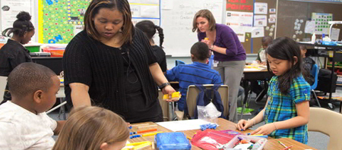
Co Teaching
The definition of co teaching is two equally qualified individuals who may not have the same area of expertise jointly delivering instruction to a group of students.

Slide 10
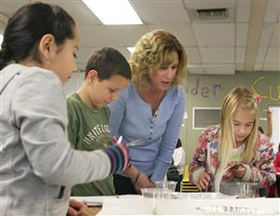
Benefits of Co Teaching
Enhances instructional support for children in the classroom
Plan, prep and prepare lessons
Work with PLCs
Lead and/or assist with lessons
Different models of co teaching
implemented
Exploratorium set-up

Slide 11
Coaching
STEM Coach:
Research STEM units and lessons
Develop STEM units and lessons within PLCs
Knowledge and application of the Next Generation Science Standards (NGSS) at all grades K-5.
Provide workshops and trainings as the need arises
Technology in the classroom

Slide 12
Robotics
BeeBots (K-1st Grades)
Teach directionality, beginning coding skills
Lego WeDos (2nd-3rd Grades)
Kits used to build and program robots
Students work with partners or small groups to problem solve, design, and redesign
HummingBird Robotics (4th-5th Grades)
Circuit boards, motors, servos, and wire connectors
Build their own robot from various materials

Slide 13
BeeBots

Slide 14
Lego WeDo Video

Slide 15
HummingBird Robotics

Slide 16
Discovery Classes
Discovery Classes:
After school, teacher volunteers
Science themed
Robotics, Science Fun, Engineering, iMovie
Two 4 week periods
Odyssey of the Mind

Slide 17
Discovery Classes Video

Slide 18
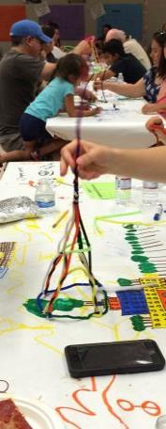
Family Involvement
STEM Parent Information Night
Family Math Night
Family Engineering Night
STEM Expo
Facebook page:
https://www.facebook.com/curranSTEM

Slide 19
STEM Expo

Slide 20
Project Based Learning
Project Based Learning is a systematic teaching method that engages students in learning essential knowledge and life enhancing skills through an extended student influenced inquiry process structured around complex authentic questions and carefully designed products.

Slide 21
Trout in the Classroom
5th Grade Project
Goal: To Re-establish suitable conditions for Steelhead runs in the Santa Margarita River
Students are raising Rainbow Trout eggs to observe lifecycle and needs of a closely related fish
Sponsored by Deep Creek Flyfishers
Program content provided by Trout Unlimited (National Organization)
Eggs are provided free through California Fish and Wildlife to trained teachers
Santa Rosa Plateau Nature Education Foundation funded the equipment and buses

Slide 22
Trout

Slide 23
Santa Rosa Plateau Seed Project
5th Grade
Students to identify native and non native plants
Grow various samples to determine the invader species
Data is collected and reported the Santa Rosa Plateau Nature Education Foundation for study. Data is used to determine the invader species
Real World Application

Slide 24
Santa Rosa Plateau Video
https://animoto.com/play/jBTtDjmPtNgF9EATjEXXvA

Slide 25
District Perspectives
MVUSD STEM Pathway
Harnessing District Support
Networking – RCOE, NSTA, CSTA, Science Steering Committee
Resources

Slide 26
District Perspectives
MVUSD STEM Pathway
Harnessing District Support
Support – RCOE, NSTA, CSTA, Science Steering Committee
Resources

Slide 27
Scientific Literacy Vision

Slide 28
MVUSD STEM Pathway
Develop a STEM emphasis elementary school
Provide a pathway from the feeder elementary school to the middle school
Designate the middle school as a STEM school
STEM Middle School feeds into a high school that has established pathway courses
Engineering
Medical
Culinary Arts

Slide 29
Harnessing District Support
Board of Education presentation
Ideals of STEM
Communication
Monthly meetings with Assistant Superintendent of Ed Services
Monthly meetings with Director of Ed Services
Attend department meetings
Implementation
Science Steering Committee

Slide 30
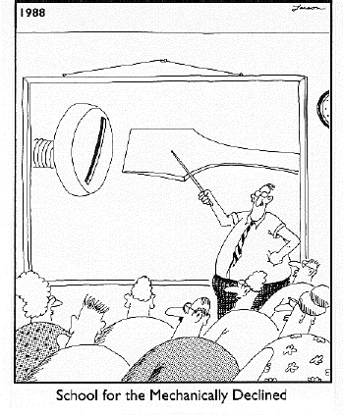
Teacher Support
County Office
Science Literacy PD for elementary
Science Steering Committee
NSTA
CSTA

Slide 31
Resources
NSTA | CSTA | NGSS | Defined STEM
Edutopia | Wonderopolis | PBL (Buck Inst) | JPL
Better Lesson | Graphite | NBC Learn | Bozeman Science
Ted Periodic Videos | Microsoft Tools | STEM School Study | Teach π
Star Talk | NASA Educators

Slide 32
Year Two: Interdisiplinary/Crosscurricular
Watch us grow on our E. Hale Curran
STEM Website!

